Slide 1
Data Science Project: Analysis of Most Streamed Spotify Songs Dataset
By: Ayushmaan

Slide 2
TABLE OF CONTENTS
01
02
03
04
Overview & Objective
Dataset Description
Introduction to the project and its objectives
Source and Features
Exploratory Data Analysis
Conclusion
Data Analysis and Visualization
Summary, Implications and Future Work

Slide 3
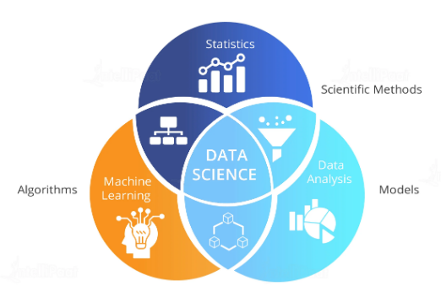

Project Overview
Objective
In this project, we delve into the world of music by analyzing a dataset of the most streamed songs on Spotify. The goal is to uncover trends, patterns, and insights that define popular music in today's streaming era. With millions of songs available, understanding what makes certain tracks more popular than others can provide valuable insights for artists, record labels, and music enthusiasts.
The primary objective of this project is to perform a comprehensive analysis of the most streamed Spotify songs dataset. By examining various features such as stream count, artist, release date, genre, and popularity score, we aim to identify key trends and factors that contribute to a song's popularity. This analysis will help in understanding the dynamics of music streaming and the factors that drive listener preferences.

Slide 4
Dataset Description
Objective
The primary objective of this project is to perform a comprehensive analysis of the most streamed Spotify songs dataset. By examining various features such as stream count, artist, release date, genre, and popularity score, we aim to identify key trends and factors that contribute to a song's popularity. This analysis will help in understanding the dynamics of music streaming and the factors that drive listener preferences.

Slide 5
Dataset Description
Source: Spotify's publicly available data on most streamed songs
Features:
Track
Album Name
Artist
Release Date
Isrc
All Time Rank
Track Score
Spotify Streams
Spotify Playlist Count
Spotify Playlist Reach
Spotify Popularity
YouTube Views
YouTube Likes
Genres

Slide 6
Exploratory Data Analysis

Slide 7
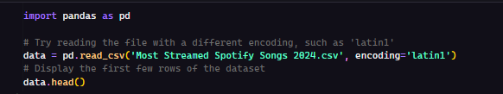
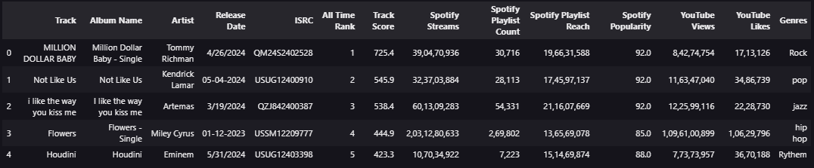
Read the dataset
This code attempts to read a CSV file named 'Most Streamed Spotify Songs 2024.csv' using the 'latin1' encoding and then displays the first few rows of the dataset.

Slide 8

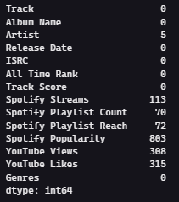
Handle null values
This code checks for missing values in the dataset and prints the sum of missing values for each column.

Slide 9
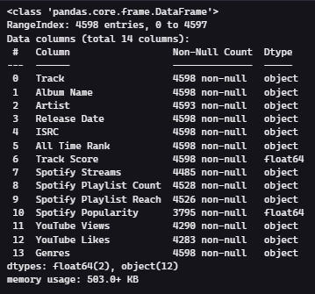

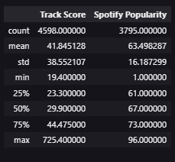
Inspect the Data
This code inspects the structure and provides a summary of the dataset and then generates summary statistics of the dataset

Slide 10
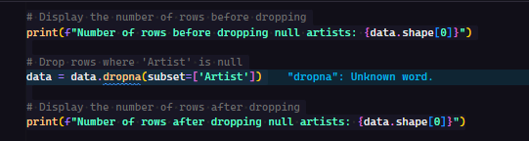

Drop rows where 'Artist' is null
This code displays the number of rows before and after dropping rows where the 'Artist' column has null values.

Slide 11
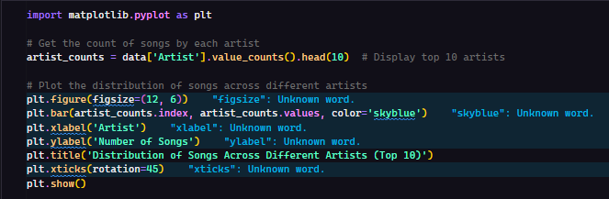
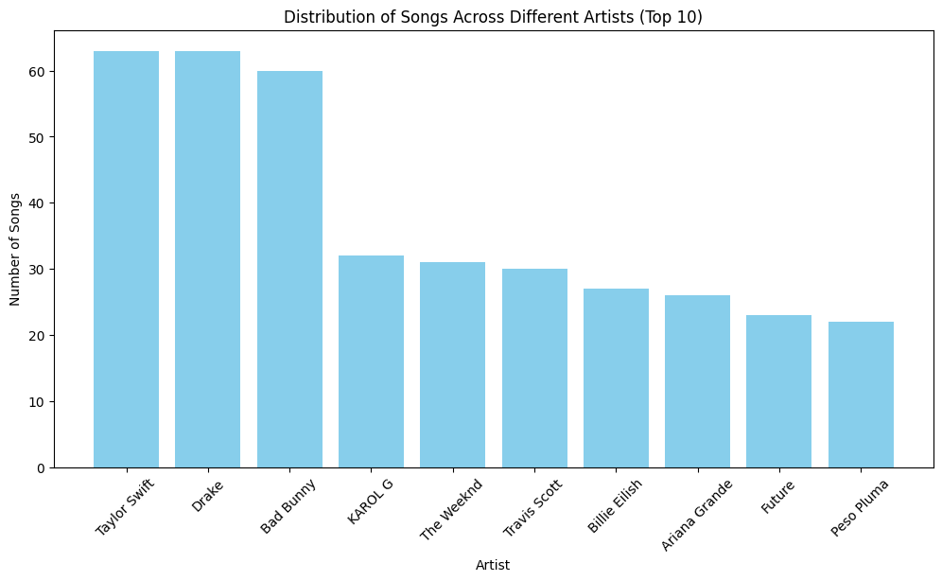
Distribution of Songs Across Different Artists (Top 10)
This code calculates the top 10 artists by song count and then plots a bar chart to display the distribution of songs across these artists using Matplotlib.

Slide 12
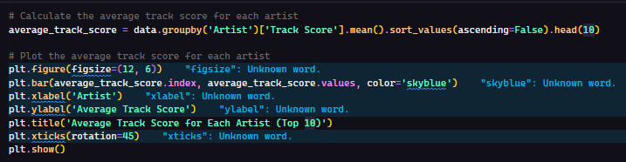
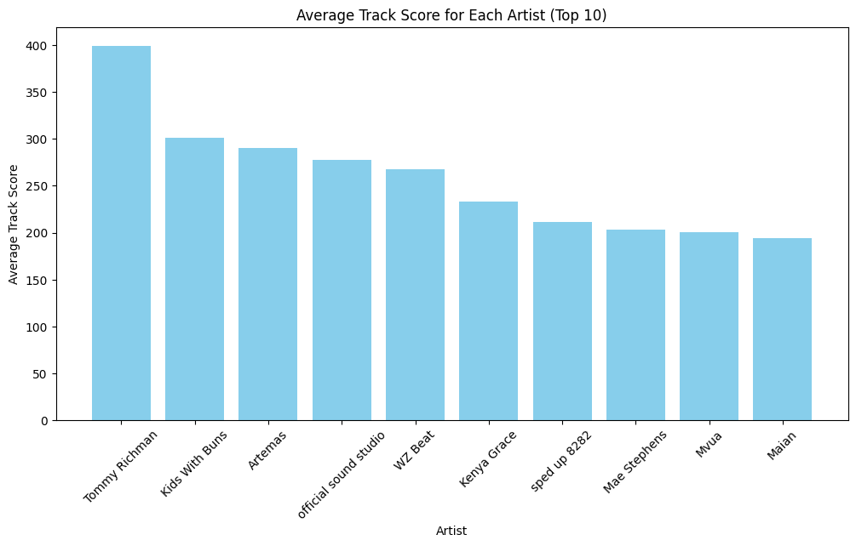
Average Track Score for Each Artist (top 10)
This code calculates the average track score for the top 10 artists and then plots a bar chart to display these average scores using Matplotlib.

Slide 13
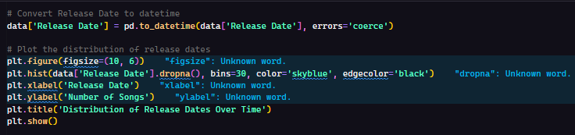
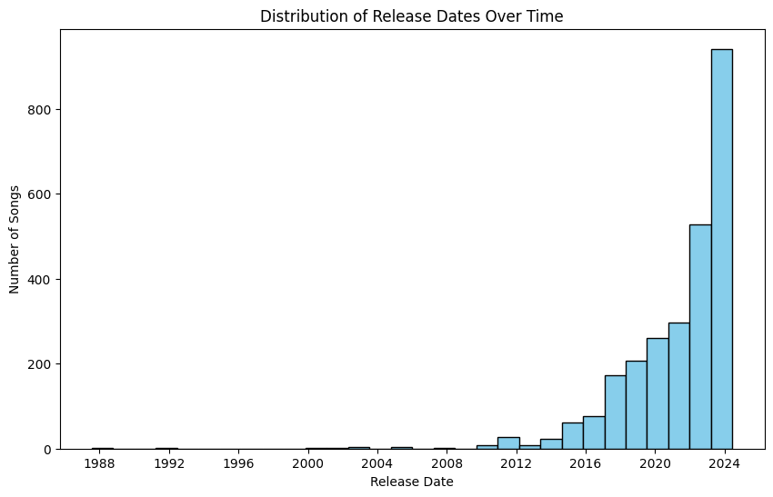
Distribution of Release Dates Over Time
This code converts the 'Release Date' column to datetime format and then plots a histogram to show the distribution of song release dates over time using Matplotlib.

Slide 14
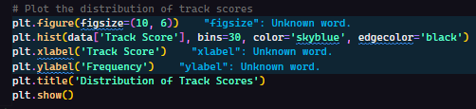
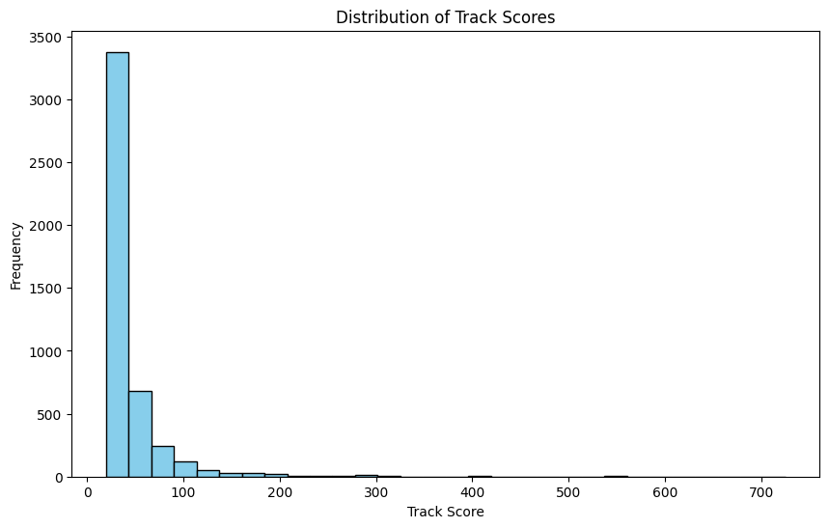
Distribution of Track Scores
This code creates a histogram that displays the frequency distribution of track scores

Slide 15
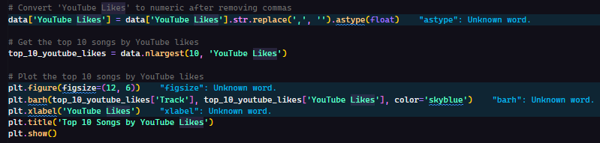
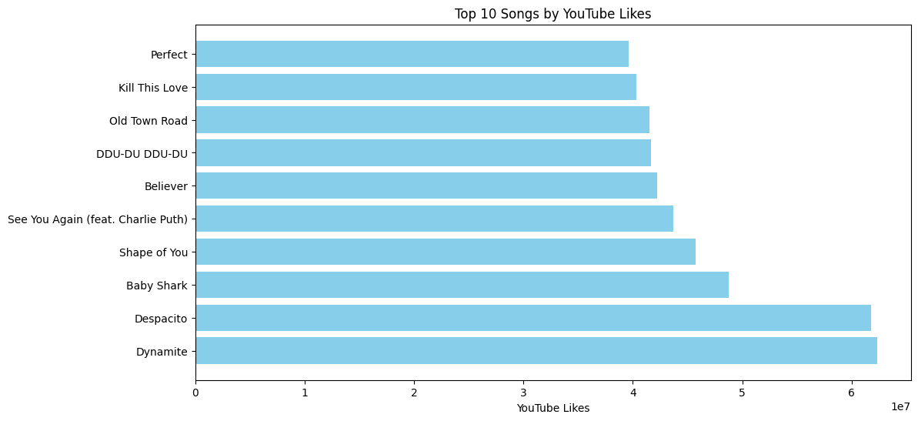
Top 10 Songs By YouTube Likes
The code converts 'YouTube Likes' to numeric values, selects the top 10 songs by YouTube likes, and plots these top 10 songs in a horizontal bar chart.

Slide 16
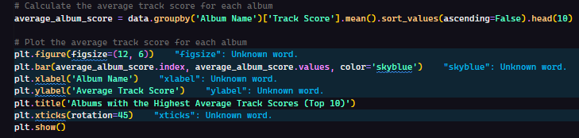
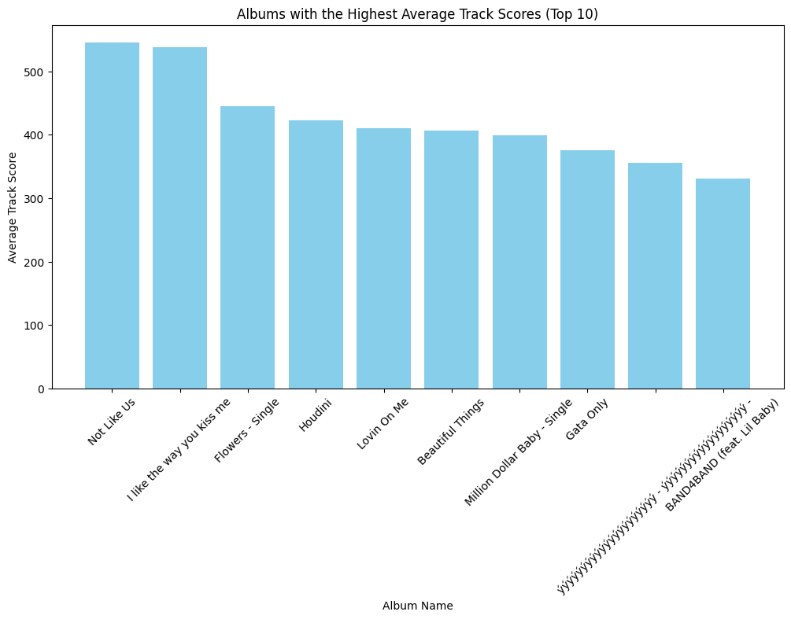
Album With Highest Average Track Scores
The code calculates the average track score for each album, sorts the top 10 albums by average score, and plots these albums in a bar chart.

Slide 17
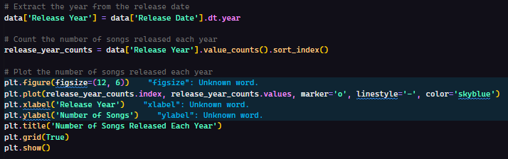
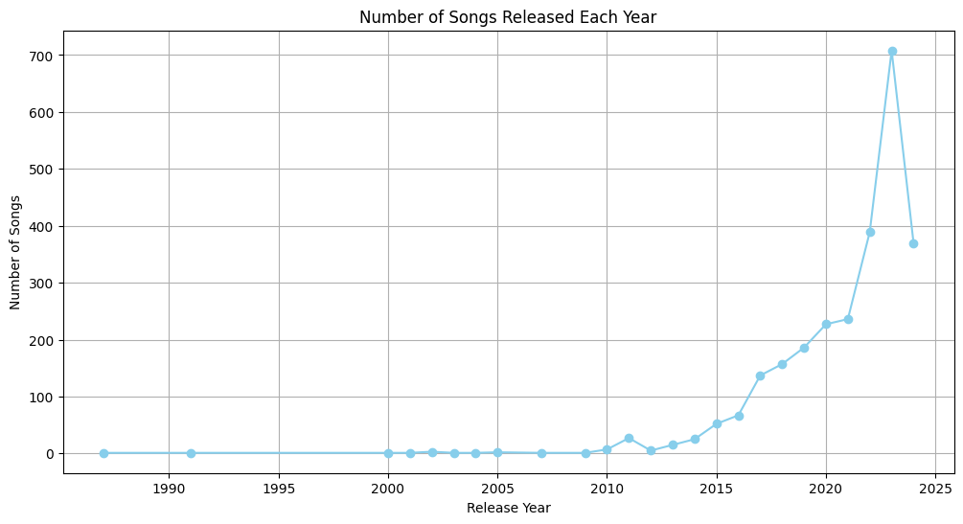
Number of Songs Released Each Year
The code extracts the release year from the release date and counts the number of songs released each year. It then plots these counts over time using a line chart.

Slide 18
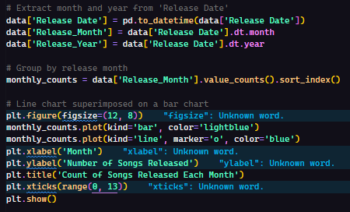
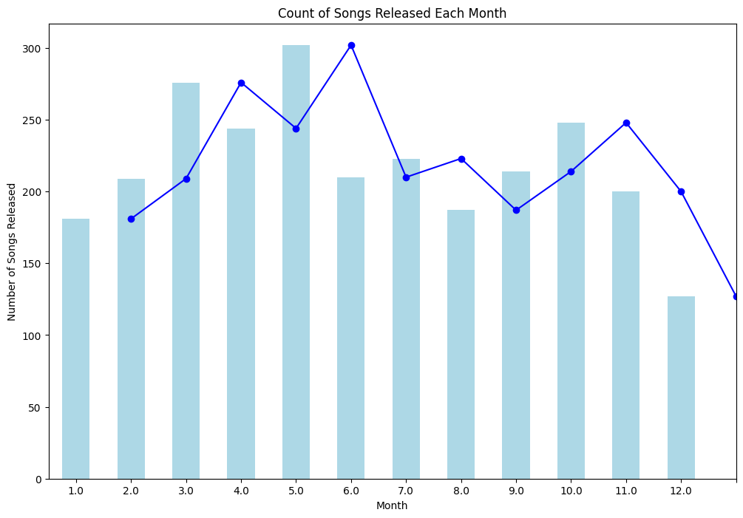
Depict Count of Songs Released Each Month on a Line Chart Superimposed on a Bar Chart
The code extracts the month and year from 'Release Date' and counts the number of songs released each month. It then plots these counts as both a bar and line chart superimposed on each other.

Slide 19
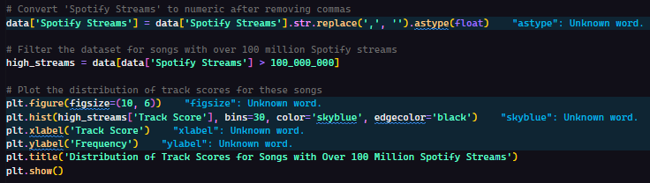
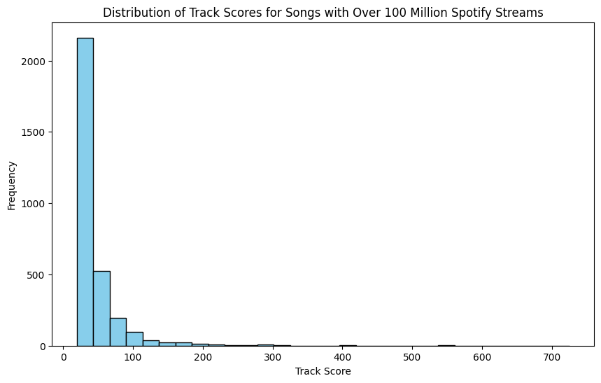
Distribution of Track Scores for Songs with Over 100 Million Spotify Steams
The code converts 'Spotify Streams' to numeric values and filters for songs with over 100 million streams. It then plots the distribution of track scores for these high-stream songs using a histogram.

Slide 20
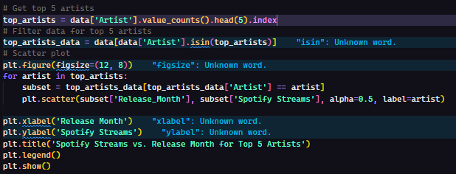
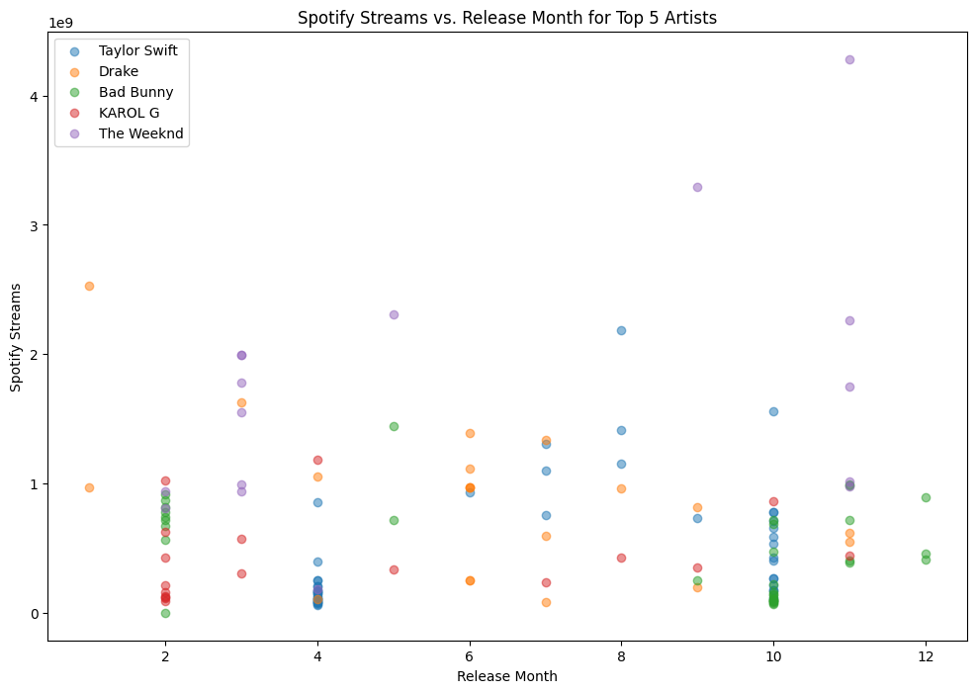
Compare Streams vs. Release Month on a Scatter Plot for the Top 5 Artists
The code identifies the top 5 artists and filters the data for these artists. It then creates a scatter plot showing Spotify streams versus release month for each top artist.

Slide 21
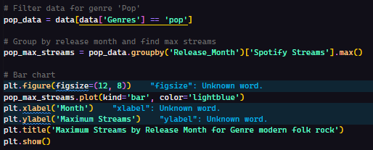
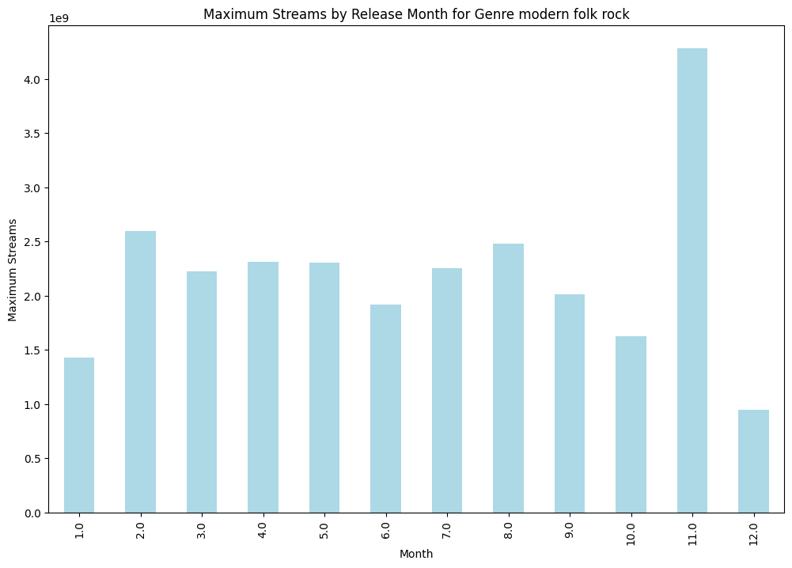
Find Maximum Streams by 'Release Month' where 'Genre' is 'modern folk rock'. Depict the Result on a Bar Chart
The code filters the dataset for the 'Pop' genre, finds the maximum Spotify streams for each release month, and plots these maximum values in a bar chart.

Slide 22
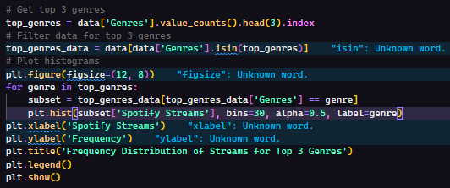
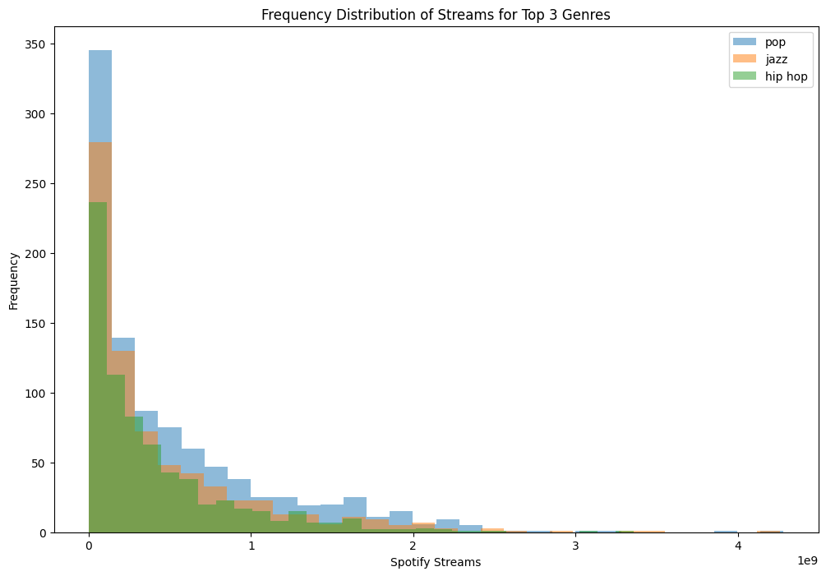
Compare Frequency Distribution of Streams for the Top 3 Genres on a Histogram
The code identifies the top 3 genres, filters the data for these genres, and plots histograms of Spotify streams for each genre to show their distribution.

Slide 23
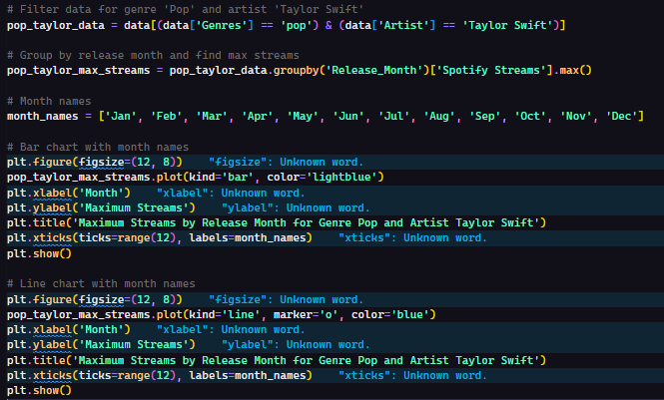
Find Maximum Streams by Release Month where Genre is 'dance pop' and Artist is 'Taylor Swift'
The code filters data for 'Pop' genre and 'Taylor Swift', calculates the maximum Spotify streams per release month, and plots these values both as a bar chart and a line chart with month names on the x-axis.

Slide 24
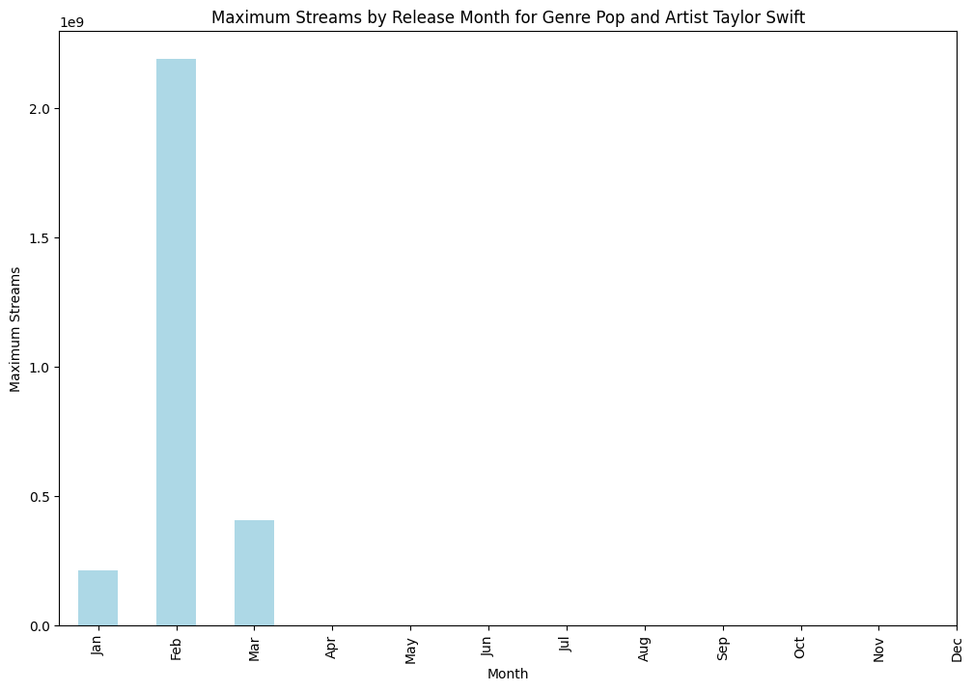
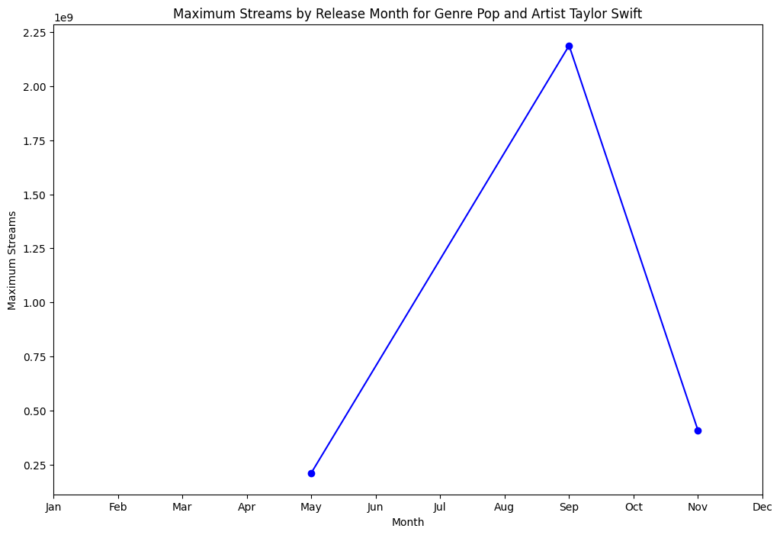
Find Maximum Streams by Release Month where Genre is 'dance pop' and Artist is 'Taylor Swift'

Slide 25
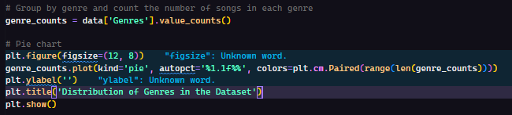
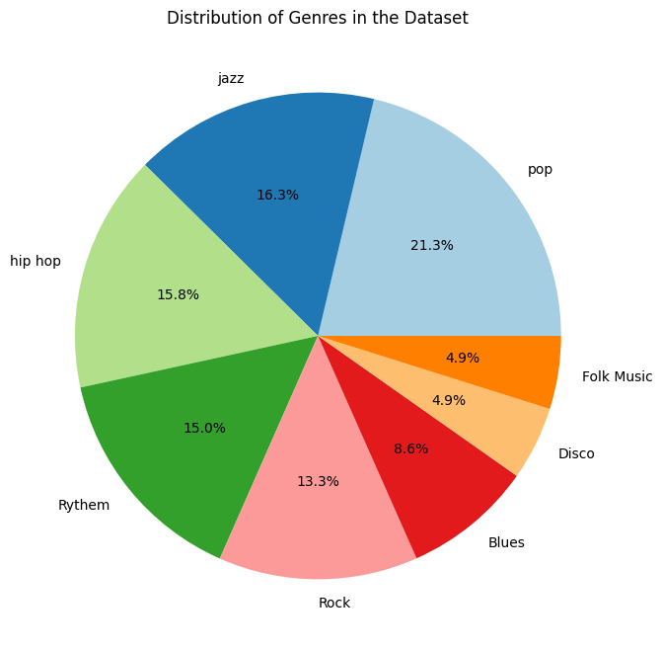
Distribution of Genres in the Dataset
This code analyzes a data frame's "Genres" column, counts occurrences of each genre, and visualizes the distribution as a pie chart.

Slide 26
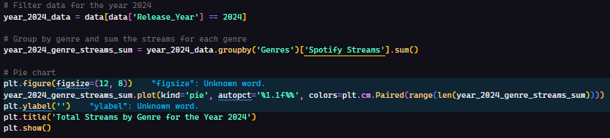
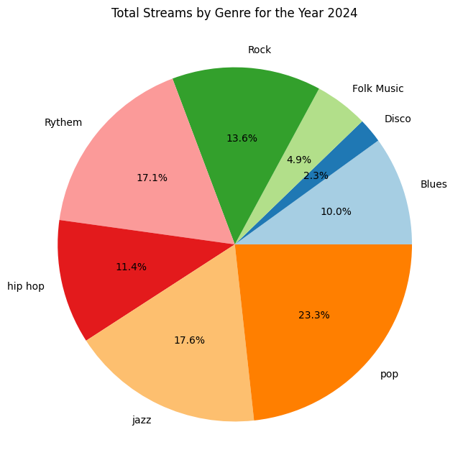
Total Streams by Genre for a Specific Year (e.g., 2024)
The provided code analyzes music data to understand the popularity of different genres in the year 2024. It filters the data to include only songs released in 2024, then calculates the total Spotify streams for each genre within that year. Finally, it visualizes this data as a pie chart to show the percentage contribution of each genre to the overall streaming activity in 2024.

Slide 27
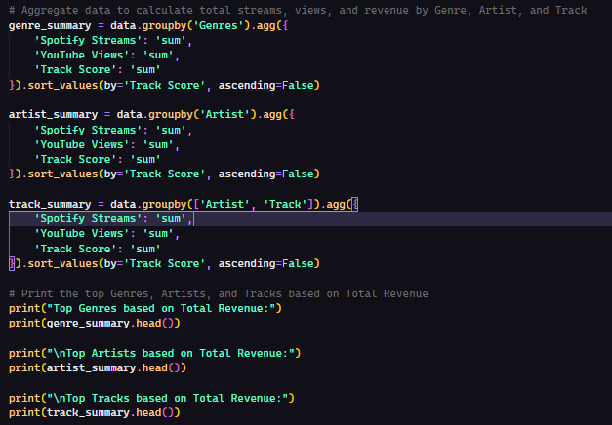
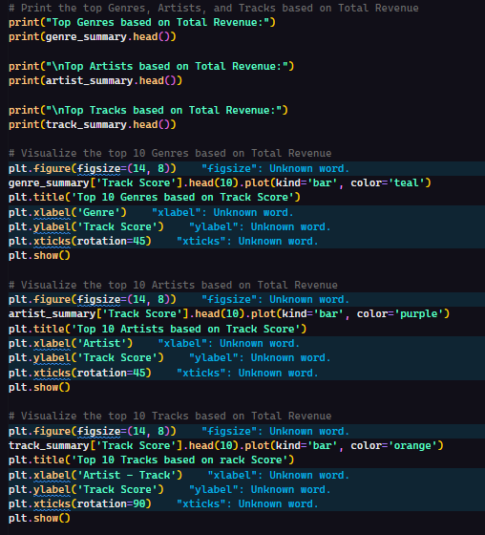
Statistically infer the Genre, Artist, and Track chosen to further expand/invest into the music business based on Spotify Streams, YouTube Views, and Track Score.

Slide 28
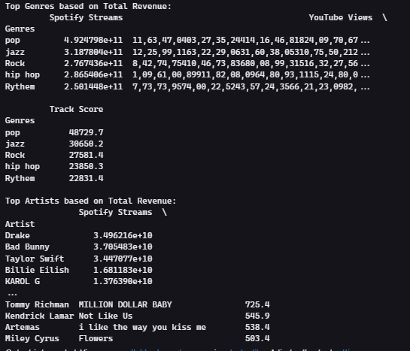
Statistically infer the Genre, Artist, and Track chosen to further expand/invest into the music business based on Spotify Streams, YouTube Views, and Track Score.
The code aggregates total Spotify streams, YouTube views, and track scores by genre, artist, and track. It then prints the top entries for each category and visualizes the top 10 genres, artists, and tracks based on track score using bar charts.

Slide 29
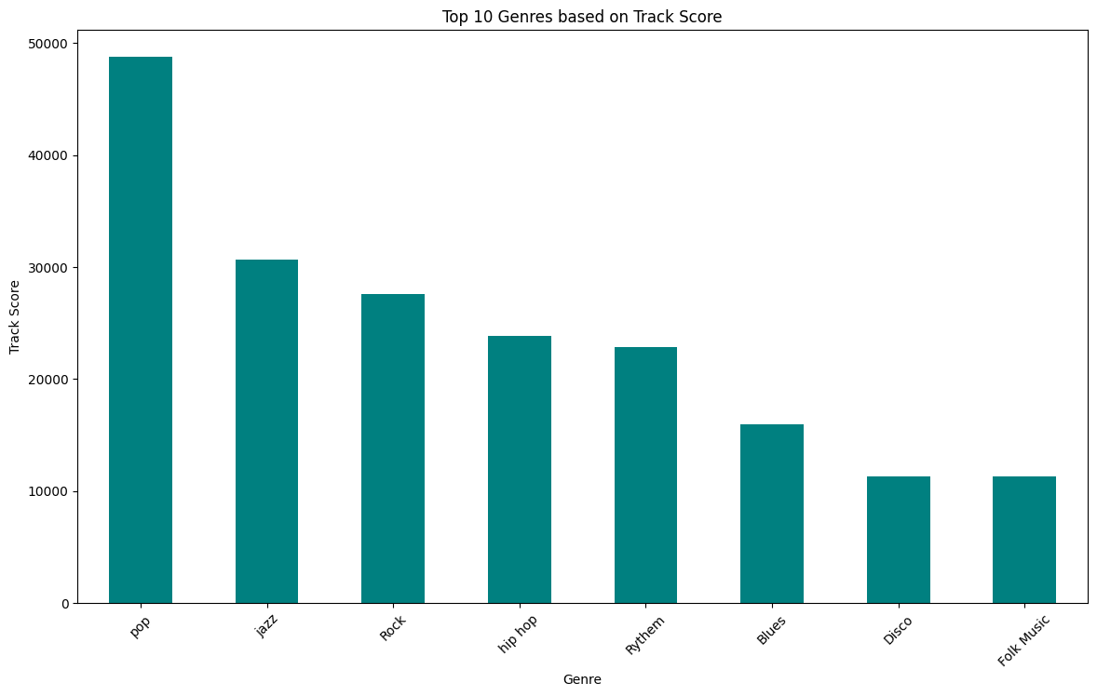
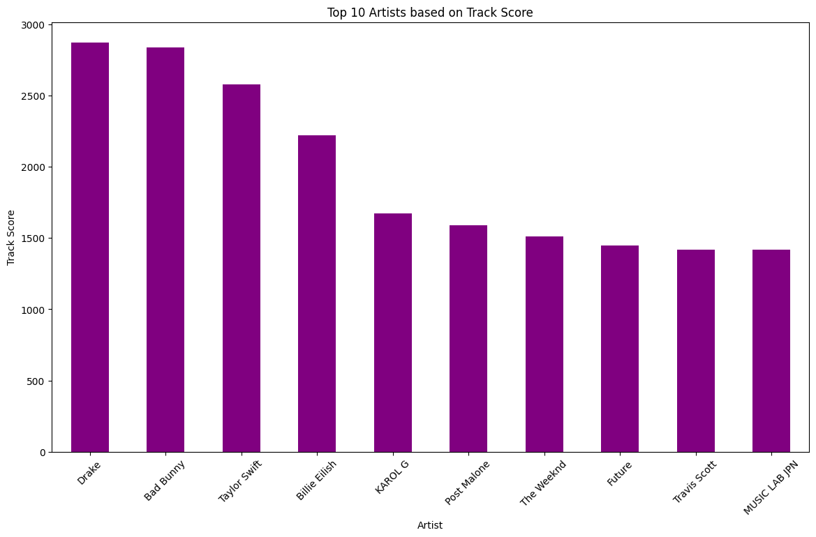
Statistically infer the Genre, Artist, and Track chosen to further expand/invest into the music business based on Spotify Streams, YouTube Views, and Track Score.

Slide 30
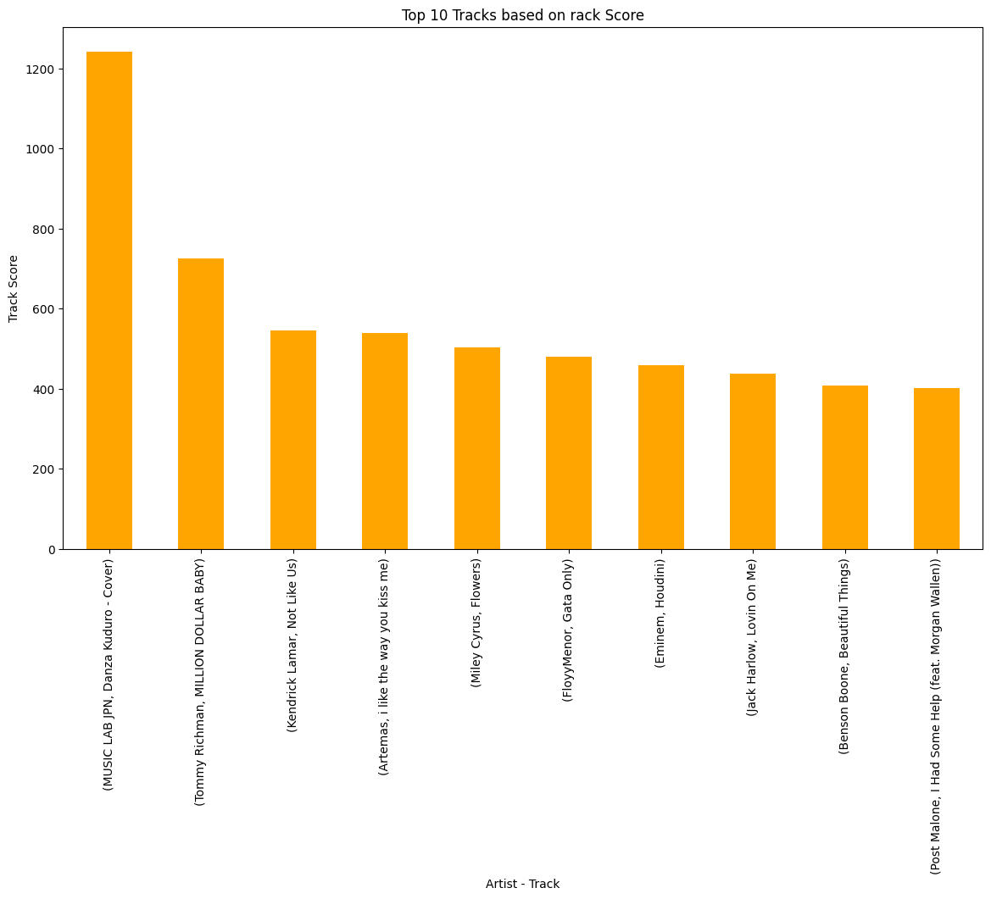
Statistically infer the Genre, Artist, and Track chosen to further expand/invest into the music business based on Spotify Streams, YouTube Views, and Track Score.

Slide 31
Conclusion

Slide 32
Summary of Key Findings:
Top Artists and Songs:
The analysis revealed the most streamed artists and songs on Spotify, highlighting significant patterns in music popularity.
Genre Trends:
Certain genres consistently appear among the most streamed songs, indicating strong listener preferences.
Release Year Insights:
There are noticeable trends in the release years of popular songs, with certain periods producing more hits.

Slide 33
Implications:
For Artists:
Understanding these trends can help artists tailor their music to align with listener preferences, potentially increasing their chances of success.
For Record Labels:
Insights from the analysis can guide marketing strategies and promotional efforts, maximizing the reach and impact of new releases.
For Music Enthusiasts:
The findings provide a deeper understanding of the current music landscape, offering a glimpse into what makes songs popular.

Slide 34
Future Work:
Expanded Dataset:
Incorporating more recent data and a broader range of features could provide even deeper insights.
Advanced Models:
Utilizing more sophisticated machine learning models to improve the accuracy of popularity predictions.
Streaming Behaviour Analysis:
Analyzing listener behavior patterns, such as playlist additions and skips, to further understand engagement with songs.

Slide 35
T
A
K
O
H
N
Y
U

Slide 36
T
A
K
O
H
N
Y
U

